Slide 1
Pipes and Iteration
Notes:
https://r4ds.had.co.nz/iteration.html

Slide 2
Workshop Objective
Understand the concepts of pipe operator (%>%): the why and when to use them
The concepts of using for loops: the why and when to use them
Basic concepts of apply
Some real world exercise on gene expression and data processing pipeline

Slide 3
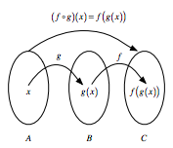
Pipes
If you have two functions, let's say f:B→C and g:A→B, you can chain these functions together by taking the output of one function and inserting it into the next.
In short, "chaining" means that you pass an intermediate result onto the next function, but you'll see more about that later.
Data %>% do_this()
%>% then_do_this()
%>% then_again_do_this()
Notes:
https://www.datacamp.com/community/tutorials/pipe-r-tutorial

Slide 4
Disclaimer
The newly updated R 4.1 includes a native pipe operation (|>)
This will not be discussed at this time since some packages that is crucial to your workflow might not longer be supported in newer packages
Some participants might not have updated to R 4.1
Essentially, the pipe operation from Magrittr (%>%) behaves similar to the new pipe operation ( |> )
Notes:
For more information on the new pipe operator, check out this:

Slide 5
Usage
Basic piping
x %>% f() is equivalent to f(x)
Using an Argument holder ( . )
x %>% f(y, .) is equivalent to f(y, x)
x %>% f(y, z = .) is equivalent to f(y, z = x)
Notes:
https://magrittr.tidyverse.org/

Slide 6
Usage - Building (unary) functions
f <- function(x){ sin(cos(x)) }
------------# is equivalent to ---------------------
f <- . %>% cos %>% sin
-----------------i.e.---------------------------------------
>f(x)
will execute sin(cos(x))
Notes:
f <- function(x){ sin(cos(x)) }, can sometimes be written as f <- function(x) sin(cos(x)) , omitting the {}. It can be done if the whole function can be contain in the same line

Slide 7
Pipes - What Is It?
Hadley Wickham continued to work on dplyr and in April 2014, the %.% operator got replaced with the one that you now know, %>%.
Subset (data, condition)
iris %>%
subset(Sepal.Length > 5)
--------------Is the same as -----------------------------------
subset(iris,Sepal.Length > 5)
Notes:
https://www.datacamp.com/community/tutorials/pipe-r-tutorial

Slide 8
Pipes - Why Use It?
round(exp(diff(log(x))), 1)
Or
x %>%
log() %>%
diff() %>%
exp() %>%
round(1)

Slide 9
Example 1
# Compute the logarithm of `x`
log(x)
# Compute the logarithm of `x`
x %>% log()

Slide 10
Example 2
# Count how many young boys with the name "Taylor" are born
sum(select(filter(babynames,sex=="M",name=="Taylor"),n))
# Do the same but now with `%>%`
Babynames %>%
filter(sex=="M",name=="Taylor") %>%
select(n) %>%
sum()

Slide 11
Example 3
# Initialize a matrix `ma`
ma <- matrix(1:12, 3, 4)
# Return the maximum of the values inputted
max(ma, nrow(ma), ncol(ma))
# Return the maximum of the values inputted
ma %>% max(nrow(.), ncol(.)

Slide 12
Iteration
Tool for reducing duplication is iteration, which helps you when you need to do the same thing to multiple inputs: repeating the same operation on different columns, or on different datasets.

Slide 13
Why we use iteration?
It’s easier to see the intent of your code, because your eyes are drawn to what’s different, not what stays the same.
It’s easier to respond to changes in requirements. As your needs change, you only need to make changes in one place, rather than remembering to change every place that you copied-and-pasted the code.
You’re likely to have fewer bugs because each line of code is used in more places

Slide 14
For()
for(i in 1:100){
print(i)
}

Slide 15
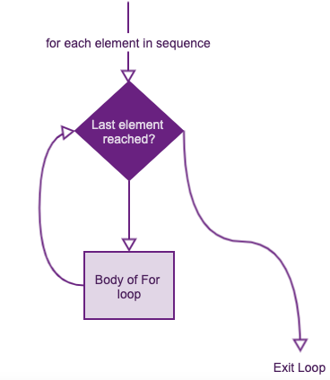
Notes:
https://r-lang.com/for-loop-in-r/

Slide 16
apply()
>df <- data.frame(x = 1:4, y = 5:8, z = 10:13)
x y z
1 5 10
2 6 11
3 7 12
4 8 13
>apply(df, 1, sum) ##apply function over rows
16 19 22 25

Slide 17
apply()
>apply(df, 2, sum) ##apply function over columns
x y z
10 26 46
#######################
>apply(df, 2, mean) ##apply function over columns
x y z
2.5 6.5 11.5

Slide 18
apply() on custom functions
fun <- function(x, character = FALSE) {
if (character == FALSE) {
x ^ 2 } else {
as.character(x ^2) }
}
##################
apply(df, 2, fun)

Slide 19
Round and curve bracket
If(x==2){run this}
function(input arguments){do this in a functions}
For(i in 1:10){do this for 10 times}
X <- {data of an array}
X <- c(1,2,3,4,5)

Slide 20
Let’s head to R
Download the script file for the workshop from github

